Slide 1
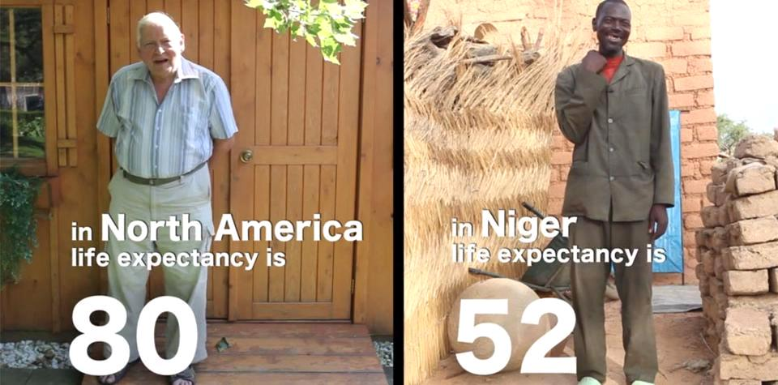
God created us equal, but we don’t
all get the same opportunities in life.

Slide 2


A new four week interest group exploring our
equality and differences with people in developing countries will take place on XXXXX at XXXXX starting XXXXX. Materials include four videos and
a discussion guide from World Renew. To sign up, contact XXXXX. Thank you!

